Slide 1
ChatApp API
By Team Freedom
Team Lead: Mengjie Zhao
Tech Lead: Yang Pan
Doc Lead: Hao Ding
Developer: Jialei Zhou, Yanshu Wei, Haoran Liang

Slide 2
Agenda
Use Case
GUI + Demo
View<=>Model Communication
API + Design Pattern

Slide 3
Use Case Diagram
The Owner might be unqualified post qualification change
Leave Room
Voluntarily
Evicted
Disconnected
Notify users in the room why/who left
If the owner leaves, notify all users in the room and close room
Login
Qualification Check
Join Room
(User)
Chat with users in the room
Set Qualification
Owner must qualify
Create Room
(Owner)
Send to all users in the room
Change Qualification

Slide 4
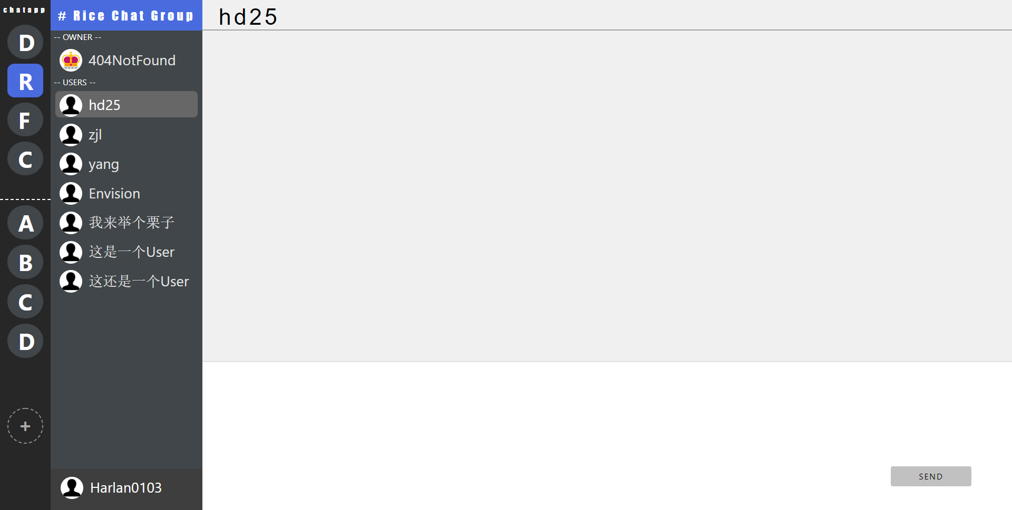
GUI Overview (Post user login)
Part 1
All rooms
Part 2
A Single Chat Room Info
& Message Box

Slide 5
GUI Part 1
Joined rooms list
Users’ interaction with room
Leave/Leave All
Voluntarily – hover on the room initial and opt to leave
Evicted – “hate” detected or no longer qualified
Disconnected – close browser etc
Join – click room initial to join
Qualification check
Create
Click “+”
Set qualification to create
All other rooms list
Create new room with qualification

Slide 6
GUI – From Part 1 to Part 2
Click the room name to show room info (room name & owner & user list)
2. Click the username to show the message box with certain user

Slide 7
GUI Part 2
Left user status
(Hidden if no user leaves)
(pop up user info & reason if user leaves)
User chat with others
Click “Send” to send message to another user
If the user is the owner of the room, the user can
Click “Send All” option to send message to all users in the room
Click “Chat Group” name to change the room qualification
Display / Update room qualification
Send Message
/ Send All
Display current user profile

Slide 8
Demo
https://chatapp-team-freedom.herokuapp.com/main.html

Slide 9
View<=>Model Communication
View is not updated every 100ms, but onevent
E.g. When receive a message from server
View will also have some logics to process the data from server to update the content it is presenting
Need to design the View<=>Model communication protocol for View and Model to interact

Slide 10
Example
BACKEND MODEL
(2)Server onMessage
Determine command type – login
Create and store the user in backend
Notify view with below info
{
type : “login”,
res: gson.toJson(User)
}
username
FRONTEND VIEW
(1)Send to model “login user1 25 US Rice”
(3)View onMessage
Determine message type - login
Initialize the GUI based on returned User info - JSON.parse(message).res
User profile
User’s joined list, available list
etc
age
location
school
Login
Joined Chat Room List
Available Chat Room List
Freedom
…

Slide 11
Some communication protocol
We implemented some of below command types and it was easy!
Command type | View sends [Command type] + | Model return [Command type] +
login | name age location school | {User Json}
create | name minAge maxAge locations schools | {User Json} with one more room in available
join | roomId | {User Json} with one room moved from available to joined to the user {User.name array} with one new user to all users in the room
leave | roomId | {User Json} with one room moved from joined to available to the user {User.name array} with one user removed to all users in the room
send | roomId userId messageString | {Message array} with one more line of message to receiver and sender
etc. | … | …

Slide 12
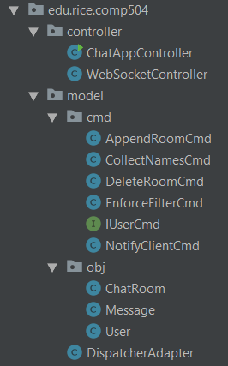
API + UML
Package controller
ChatAppController
WebSocketController
Package model.cmd
5 concrete commands
Package model.obj
ChatRoom
Message
User
Package model
DispatcherAdapter

Slide 13
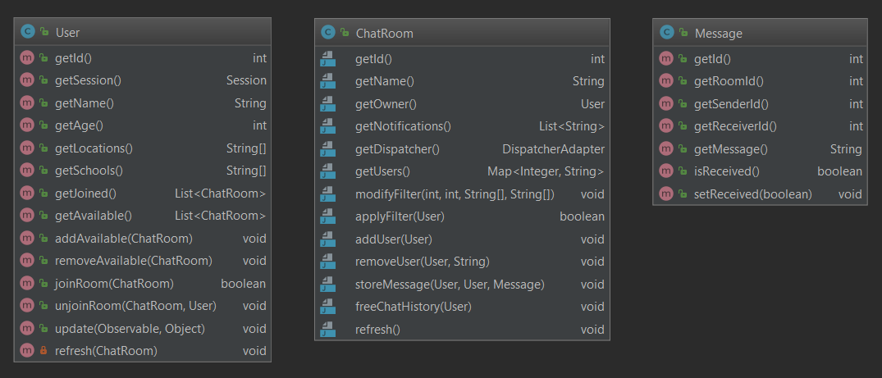
Package model.obj
User’s info
Room’s info
Message’s info
Room’s Response to User Action
User’s Action

Slide 14
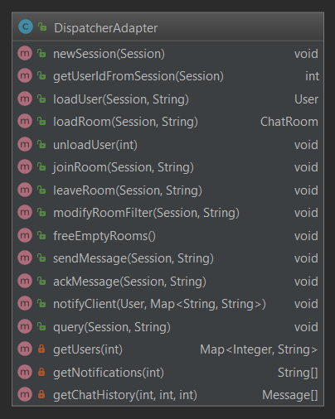
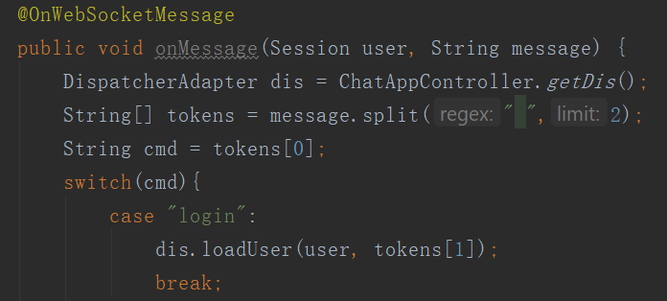
Dispatcher Adapter
The global storage for all chatrooms and sessions(users)
In HashMap
Methods called from WebSocketController to handle different requests from client
login msg, create msg, etc.
Analogous to endpoint in 504 hw

Slide 15
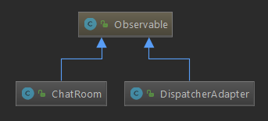
Design Pattern Part 1
Observable
Observer
User
Observable
Dispatcher
Dispatcher will notify all existing users
ChatRoom
ChatRoom will notify all users in the room

Slide 16
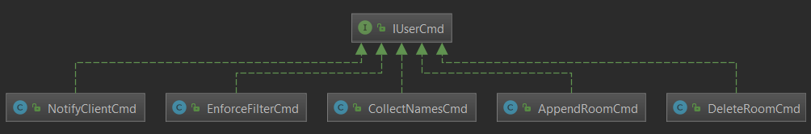
Design Pattern Part 2
Command
Dispatcher
AppendRoomCmd - All global users - a new room is created
DeleteRoomCmd - All global users - a existing room is deleted (owner left)
ChatRoom
EnforceFilterCmd - All room users - owner changes the room qualification
CollectNamesCmd - All room users – collect all user names upon user joining/leaving
NotifyClientCmd - All room users – send info to view

Slide 17
Example – Create Room3
Joined Room
Room1
Room2
Available Room
Room3
User1
Room1
User1
Joined Room
Room2
Available Room
Room1
Room3
loadRoom
DispatcherAdapter
Room2
User1
User2
User2
3. notifyObservers(cmd)
Add the new room into available
1. Create new room
Room3
Joined Room
Available Room
Room1
Room2
Room3
AppendRoom Cmd
User3
Room3
2. Wrap the room in AppendRoom Cmd

Slide 18
Example – User3 join Room1
User1
User3
joinRoom
DispatcherAdapter
NotifyClientCmd
{content: [user1, user3]}
Joined Room
Room1
Available Room
Room1
Room2
Room3
User3
3. Wrap new user list in NotifyClientCmd to notify all clients in Room1
1. Pass to User Class to update User3’s joined available list
Room1.addUser(User3)
ChatRoom
User3.joinRoom(Room1)
User
Room1
User1
User3
2. Pass to ChatRoom Class to add User3 into Room1’s observer

Slide 19
Q&A

